Slide 1

Project No. 06
PROMOTION OF BEE-KEEPING
MPR of HADP
July , 2025
SKUAST-Kashmir for Quality Life

Slide 2
MPR, July 2025
Target /Interventions | Budget Allocation | Funds Released | Expenditure up to 31st of March 2025 | Expenditure for the m/o July, 2025 | Achievements for the m/o July , 2025
Bee breeding centre for climate smart bees | 50 lakhs (2025-26) | 25 lakhs | 1.617 cr | Expenditure 25 Lakhs Polarimeter bill has been submitted in the comptroller office SKUAST- Kashmir Funds has been released for the year 2025-2026 = 25 lakhs Liability for the year2024-25= 50lakhs Requisition for budget enhancement of Rs 30 Lakhs to the already sanctioned amount i.e., Rs 50 Lakhs for the smooth functioning of project | Installation of OTC (Open Top Chamber) system is completed
Disease diagnostic and quarantine centre |  |  |  |  | Targets for establishment of Disease diagnostic and quarantine centre is completed with all equipment's functional
Production of nucleus stock |  |  |  |  | Production of nucleus stock Is initiated Establishment of Insect Mini museum at Division of Entomology, SKUAST-K
 |  |  |  |  | Action Plan for the Financial year 2025-2026 has been made and forwarded it to the Directorate of Research (HADP Cell). All the Equipment's purchased under HADP-06 Project has been made functional and demonstration is carried out. Procurement Plan for the FY 2025-2026 has been Submitted to Directorate of Research
Production of bee colonies by bee breeders

Slide 3
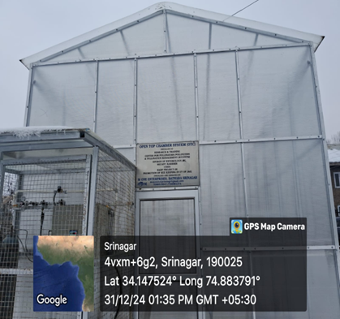
OPEN TOP CHAMBER

Slide 4
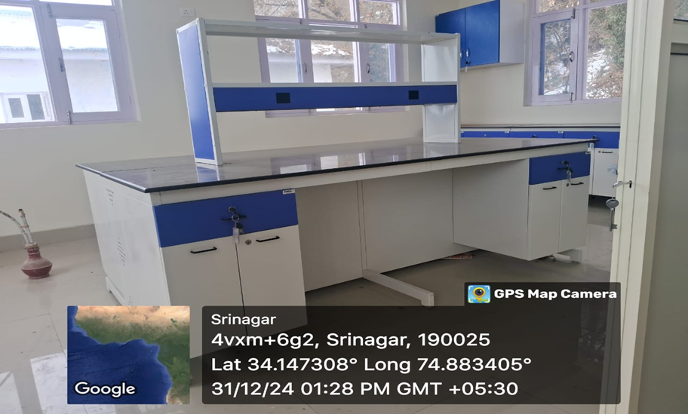
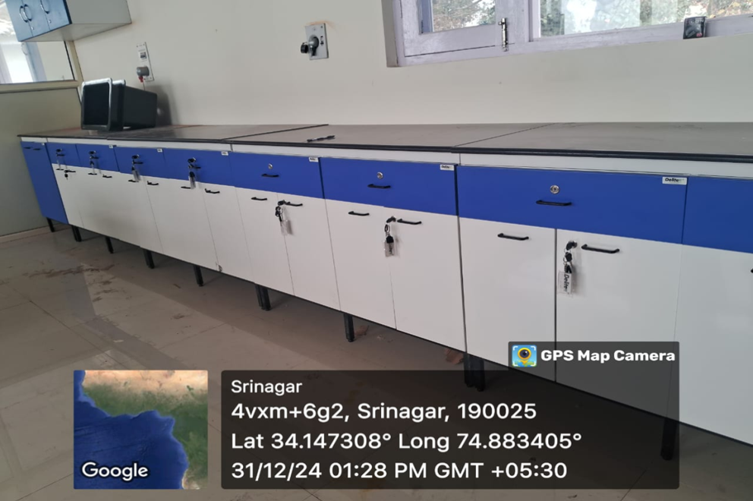
DISEASES DIGONOSTIC AND QURENTINE CENTER

Slide 5
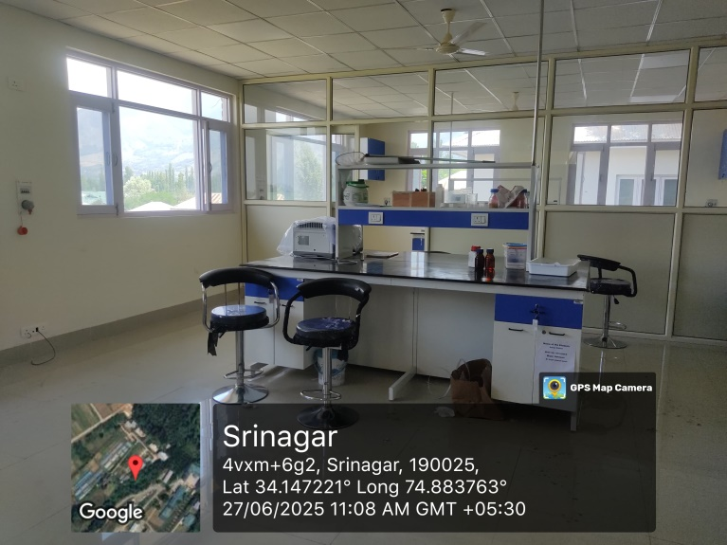
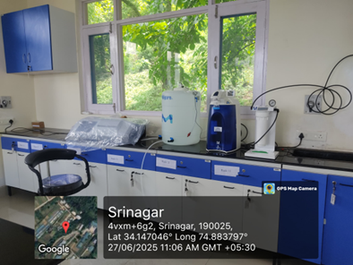
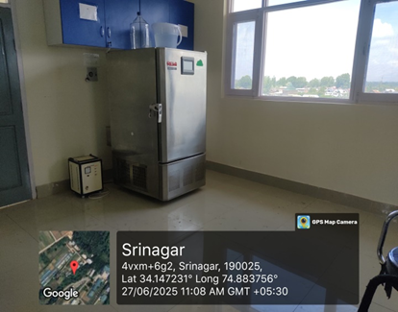
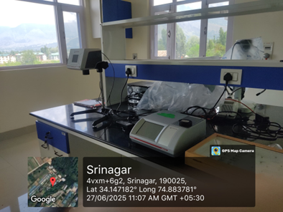
ALL THE EQUIPMENTS ARE FUNCTIONAL IN DISEASES DIGONOSTIC AND QURENTINE CENTER

Slide 6
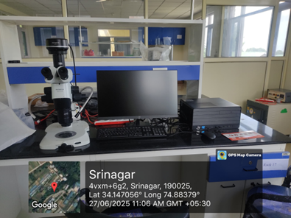
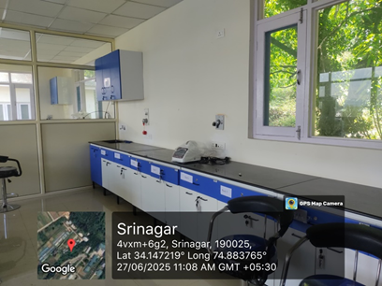

Slide 7
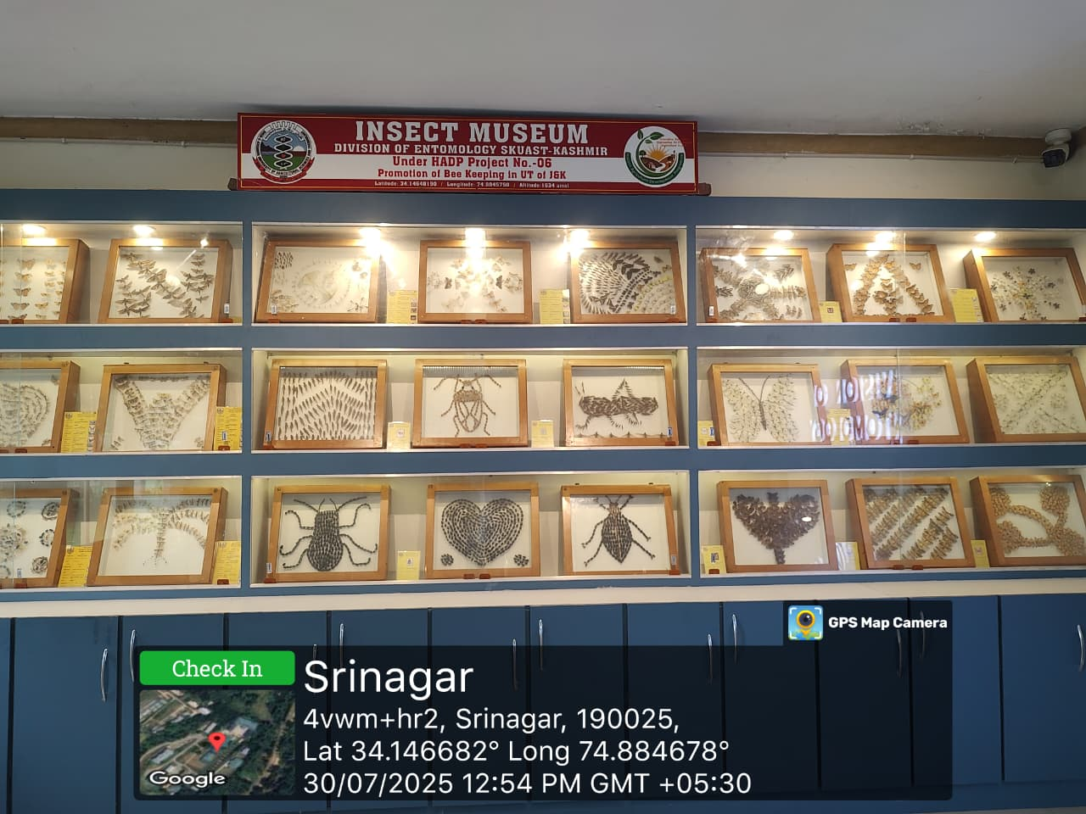
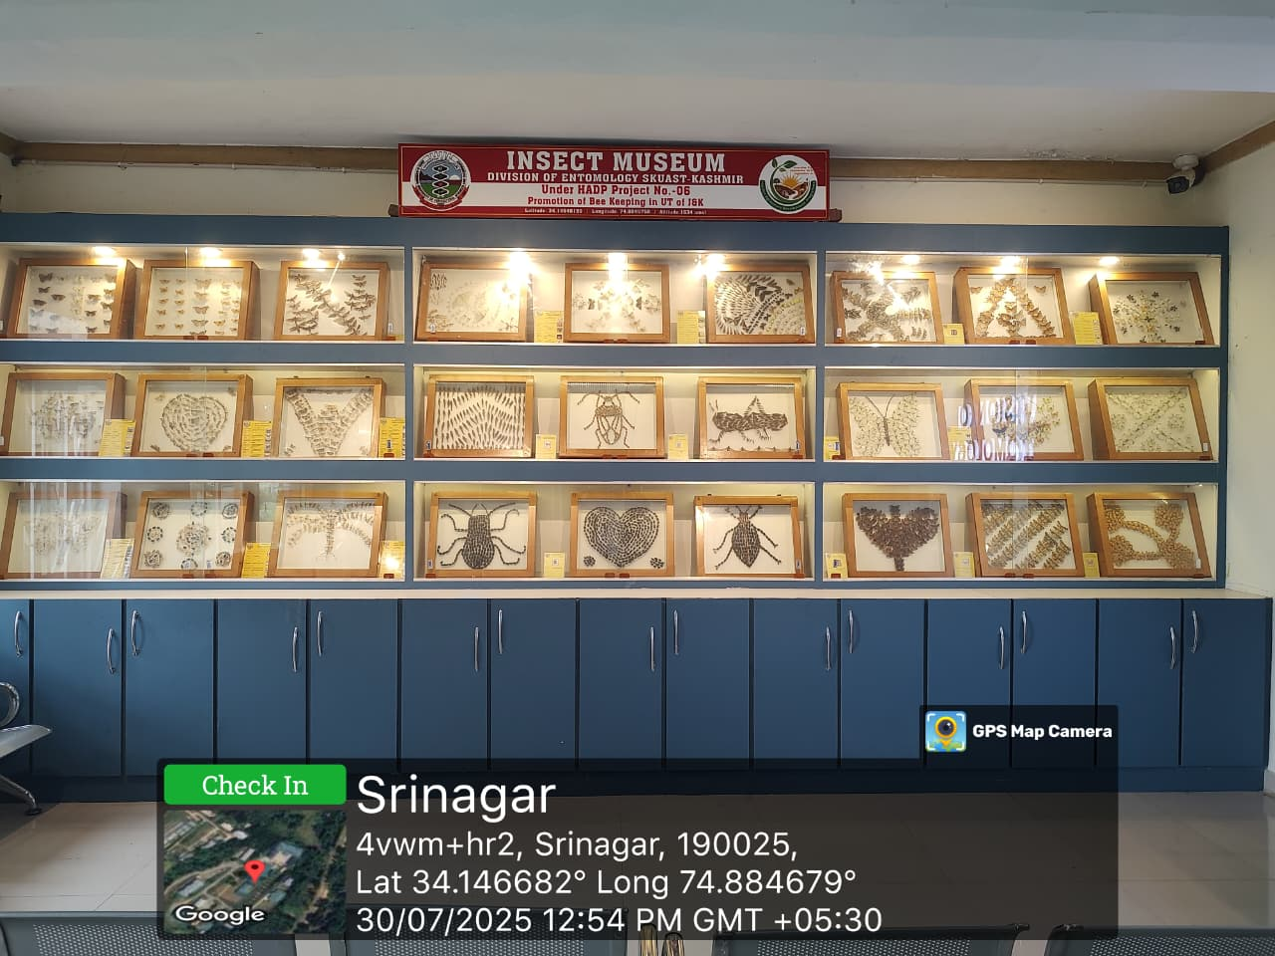
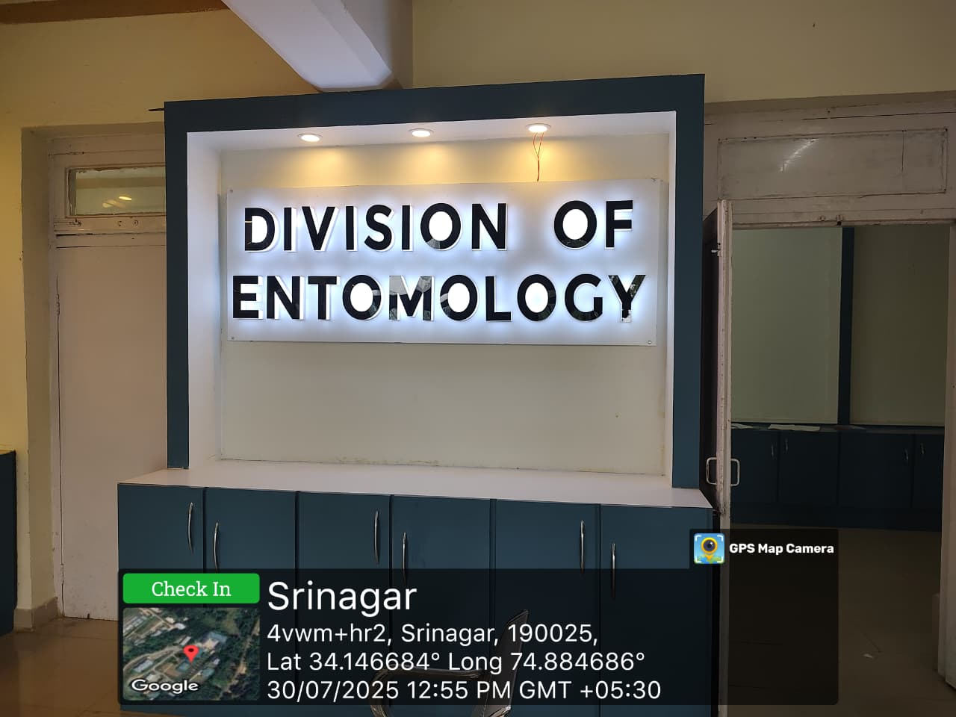
Insect Mini-Museum

